Slide 1
Obtaining supplier qualifications to participate in tender procedures
JTPP Webinar
Topic 1
Topic 2
Topic 3
Topic 4
Contact
Japan Tax and Public Procurement (JTPP) Helpdesk
Lyckle Griek –
JTTP Project manager
www.EUbusinessinJapan.eu
Notes:
Thank your for joining us today! Today, I want to discuss with you one of the special aspects of public procurement in Japan, the supplier qualifications.

Slide 2
Today’s topics
Topic 1
Topic 2
Topic 3
Topic 4
Contact
Why?
To assess beforehand the capabilities and financial soundness of prospective suppliers
Classify suppliers and reserve contracts for suitable suppliers
Unified Supplier Qualification system
Outline
How to get it
Tender participation qualification for construction and design
Outline
How to get it
Supplier Qualification at regional/local level
Case: Tokyo Metropolitan Government
How to get it
www.EUbusinessinJapan.eu
Notes:
For companies or individuals who wish to supply their goods and services to Japanese government organizations at all levels, be it national, regional or local, it is necessary to qualify as a supplier. If you want to take part in a competitive tender procedure, possession of this qualification is one of the preconditions. There are a number of types of qualifications, which differ in the scope of services or products covered and the area where they are valid.
In this webinar I will look at three:
The Unified supplier Qualification system, which deals with supplying goods and services to national government entities, such as ministries, and has the largest scope.
Qualification for construction and design related tendering, which in part has national-wide common features, but needs to be obtained at each and every government organization separately.
Supplier Qualification at the regional and local level. I will look here at TMG as an example.
What the qualifications have in common is that they are used to assess the capabilities and financial soundness of prospective suppliers to Japanese government organizations
It is also used to classify suppliers and reserve or limit particular contracts for suppliers that will be able to fulfill the obligations of the contract.

Slide 3
http://www.chotatujoho.go.jp/va/com/ShikakuTop.html
Notes:
Let’s start with the Unified Supplier Qualification system. This is a screenshot from the GEPS website page which gives access to the page to apply for the qualification.

Slide 4
Unified supplier Qualification
Topic 1
Topic 2
Topic 3
Topic 4
Contact
“tou-itsu shikaku shinsa” (lit. unified qualification examination)
Coverage: Goods and services only
Scope: national government entities
www.EUbusinessinJapan.eu
Notes:
The tou-itsu shikaku shinsa is primarily a bureaucratic hurdle that needs to be taken if you wish participate in a tender procedure or supply directly to a Japanese national government entity.
It is not an examination that you can fail. If you have a legitimate business, you can receive this qualification without any problem.
While the paperwork for this is of course somewhat time-consuming, the advantage of the unified qualification is that the application at one ministry will allow you to participate as a supplier in tender procedures at all other ministries as well, without having to apply again.
Coverage:
The qualification is only valid for tender procedures concerning supply of goods and services. For construction and design service separate qualification service exists, as we will see later.
Scope:
Scope of the qualification is limited to national government entities and attached organisations. The qualification is not valid for tendering at regional level, such as prefectural government organisations, or organizations run by local municipalities.

Slide 5
Unified supplier Qualification
Topic 1
Topic 2
Topic 3
Topic 4
Contact
Scope:
Central ministries
Their regional offices
Government agencies
Attached institutions
National universities
Research facilities and institutes
National Hospitals
www.EUbusinessinJapan.eu
Notes:
To give you an idea of the organizations which are covered under the Unified supplier Qualifications.
As I said it includes all central ministries, but also their regional offices, government agencies and attached institutions such as nationally administered universities, research facilities and hospitals.

Slide 6
Unified supplier Qualification
Topic 1
Topic 2
Topic 3
Topic 4
Contact
“tou-itsu shikaku shinsa” (lit. unified qualification examination)
Coverage: Goods and services only
Scope: national government entities
Validity for max. three years
Currently 2016-2019
Costs for application: free
Where: online and at designated counters
Time to process: 5-10 business days
www.EUbusinessinJapan.eu
Notes:
Validity
The validity of this qualification is for a maximum of three years and uses set periods. The new period is from is for Japanese fiscal years of 2016 tot 2019, which is valid from April 2016 until March 2020. Actually, this month is the period where all current suppliers are renewing their qualifications in order to be in time for April. You can however always apply for throughout the year, but the validity will be shorter.
Costs:
The Application itself is free of costs, but you are likely to incur costs for Japanese translations etc.
Where:
You can apply at designated counters at participating organisations. It is possible to apply online. You can send the application by mail or bring it in person. (From our experience, bringing it in person is recommended, because then you can have your documents checked on the spot, to see whether it is complete.
Time to process
your request is about 5 to 10 business days, after you have submitted your application and provided that all documents are correctly filled in and complete.

Slide 7
Unified supplier Qualification
Topic 1
Topic 2
Topic 3
Topic 4
Contact
Application process in practice
Online application
Download application forms
https://www.chotatujoho.go.jp/va/com/ShikakuTop.html
All in Japanese
www.EUbusinessinJapan.eu
Notes:
Let’s have a closer look at the application process in practice, to give you an idea of what is needed.
I’m explaining here primarily in the case of a first-time application which is done on paper. The online version entails basically the same information and you have to send additional documents by mail. (Get in touch if you have questions about the online procedure)
Application forms are available online at the site, in excel and pdf versions The site also has detailed guides in Japanese to fill in the forms.
Please be aware that the entire process is Japanese, and that all documents submitted will have to have translations into Japanese.

Slide 8
Unified supplier Qualification
Documents to submit
Topic 1
Topic 2
Topic 3
Topic 4
Contact
Required | Company/individual | Document
Y | All | Application form
Y | Company | Company registration (copy + translation)
Y | All | Proof of payment of taxes (copy + translation)
Y | All | Financial Statement (1 year) (copy + translation)
Y | All | Business History
Y | Company | Signed pledge and list of executives
N | All | Letter of attorney (if necessary)
N | All | Foreign character notification (if necessary)
N | All | Detailed report on depreciation of assets (if necessary)
www.EUbusinessinJapan.eu
Notes:
This is a list of the documents that you need to submit for your application.
As I said, all these documents need to be submitted in Japanese.
For documents issued in your country of residence, such as company registration and proof of payment of taxes, you need to submit a copy of the original document, with the Japanese translation attached.

Slide 9
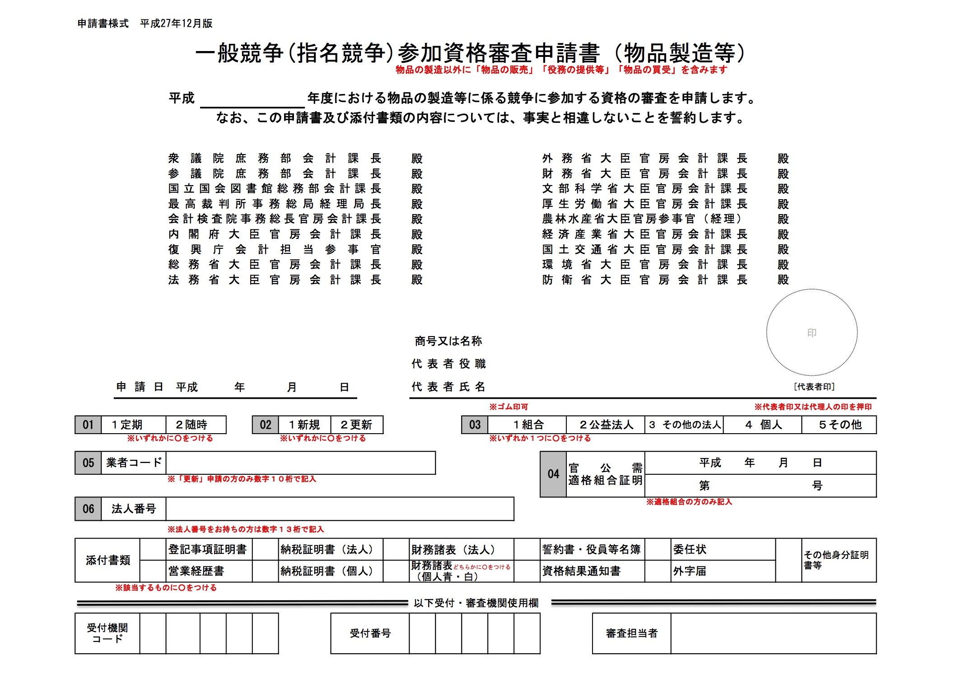
1
2
Notes:
Let me walk you through through the main documents that you need to submit.
This is the first page of the 5-page application form, as I said they are all in Japanese. There is not enough time today to go through the documents in detail, but I want to point out a few things, that might cause questions when doing the application.
Points
In Japan one is used to use seals instead of signatures, however foreign companies are allowed to use their written signature. (If you are using a Japanese representative, they can sign here with their seal)
This question is about the type of supplier that you are (individuals can also apply) But It might be good to know as well that one can also apply as a cooperative of companies or JV. In this case, the combined figures of the group will allow you obtain a higher qualification and compete for larger contracts.

Slide 10
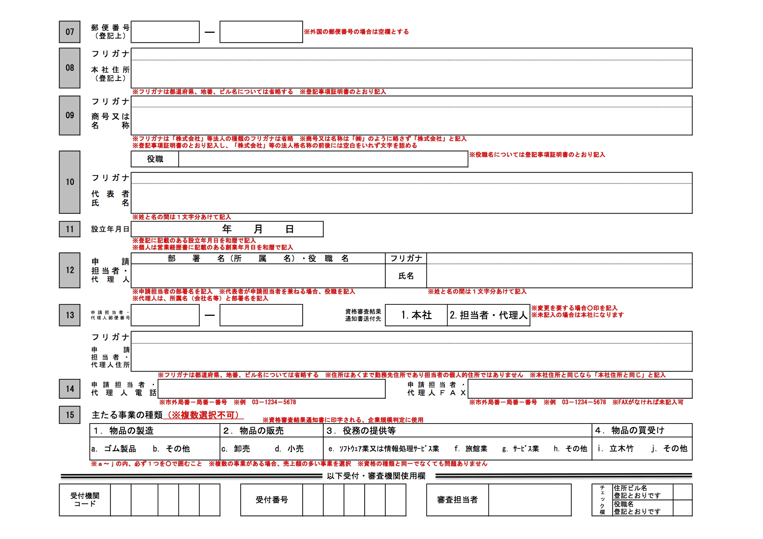
3
Notes:
Page 2 contains of primarily of standard questions regarding address, official name of your company (Make sure that it is the same as the one on your company registration)
name of formal representative. Date of establishment. Person in charge of the application (or representative) with contact details.
3. Here you need to specify your main business activities, either manufacturing of goods, sales of goods or provision of service or whether you want to buy goods from the government. Note that you can only chose one option here. But you can still engage in both manufacturing of goods for the government or just sales of goods. But please think carefully about what you regard as your main business activity, finished product of tailor-made production of goods for your client.

Slide 11
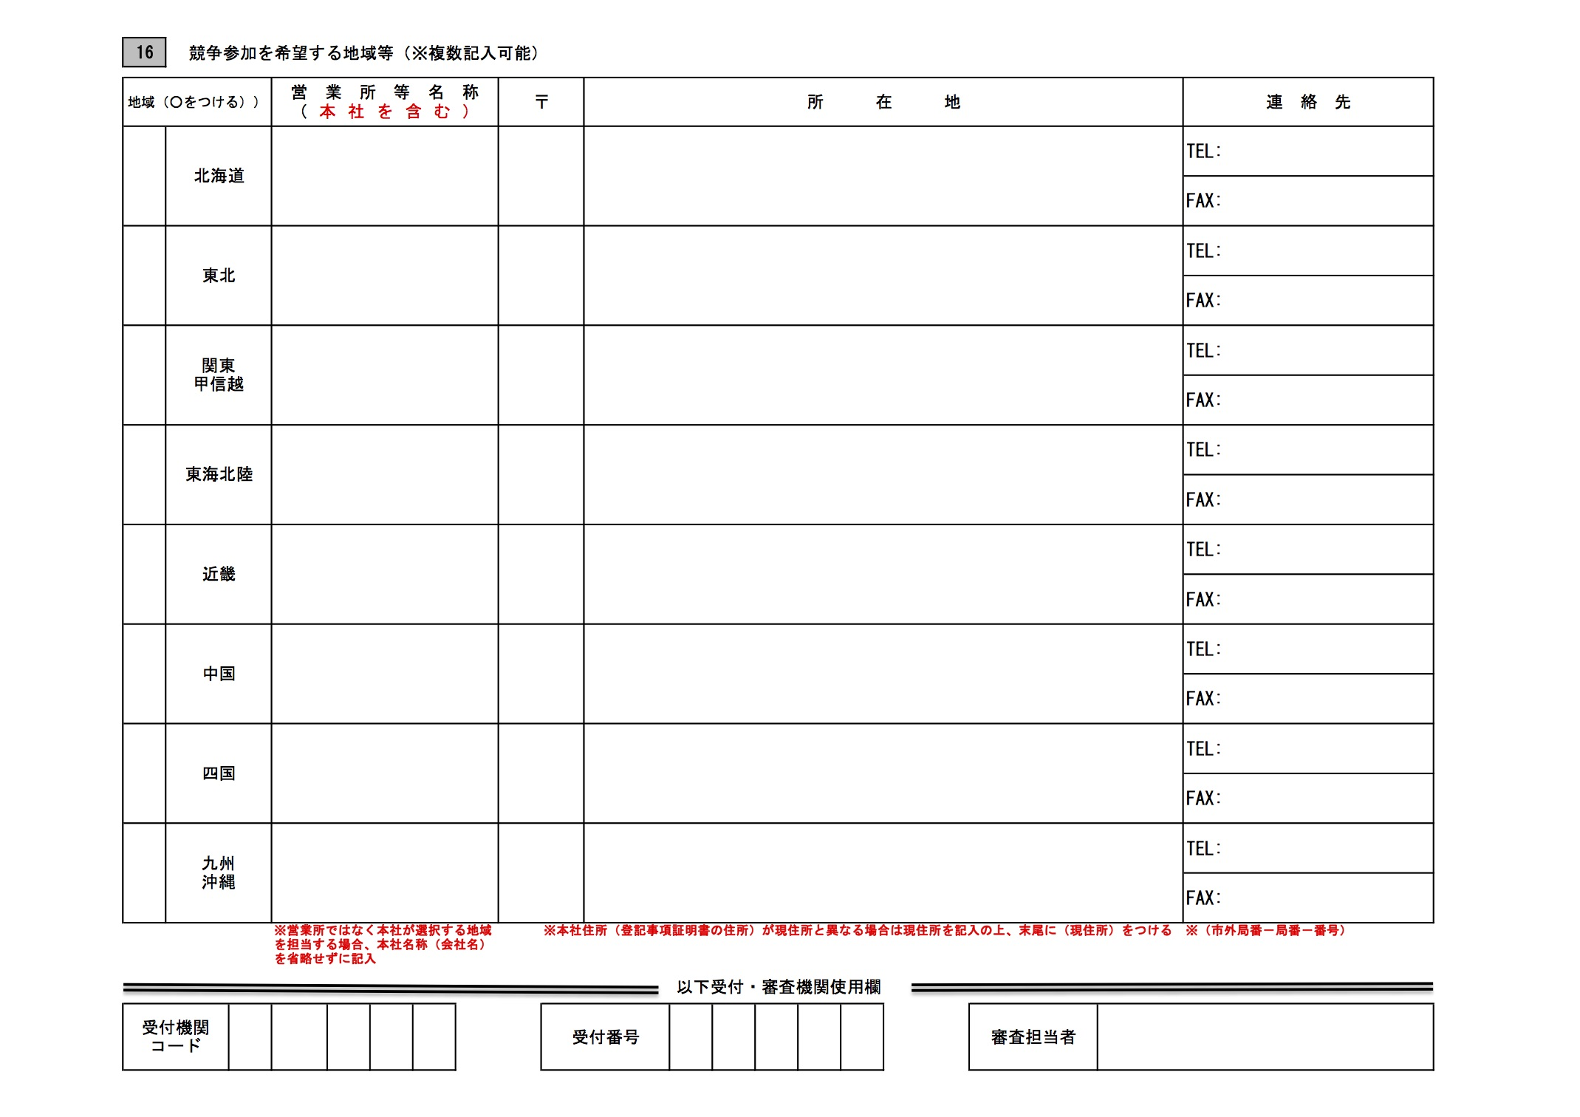
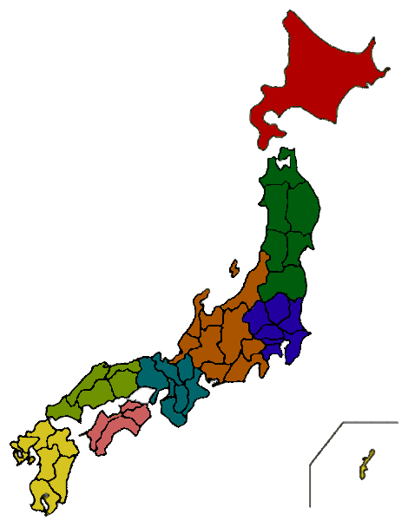
Hokkaido
Tohoku
Tokai-
Hokuriku
Kanto-
Koshinetsu
Chugoku
Kinki
Kyushu-Okinawa
Notes:
This page you need to list the contact data of your company in each of the regions of Japan where you are planning to be active.
The Japanese public procurement system has divided the country into eight regions, Hokkaido, Tohoku (North-eastern Japan), Kanto-Koshinetsu (Tokyo and surrounding prefectures), Tokai-Hokuriku
In practice we suggest you to obtain the qualification for all regions, there is no geographical limitation, so you won’t have problems later on.

Slide 12
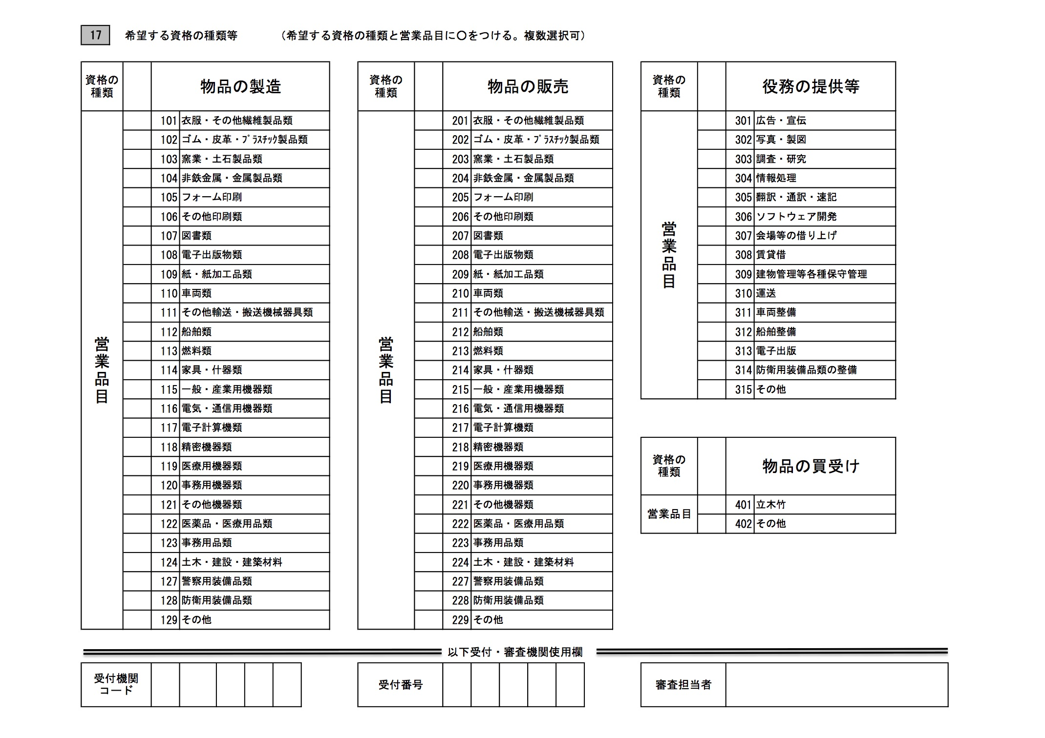
Sales of goods
Provision of services
Manufacturing of goods
Notes:
This pages lists a large number of business or product categories, for which you wish your supplier qualification to be valid for.
Multiple selections are possible here. The main division here is between manufacturing sales of goods and provision of services.
It makes sense to select a broad range as possible matching closest your business activities, as this qualification is used to select suitable suppliers for certain tenders.

Slide 13
Manufacturing |  | Sales of products |  | Services
101 | Clothing and textile goods | 201 | Clothing and textile goods | 302 | Photography and cartography
102 | Rubber, leather and plastics products | 202 | Rubber, leather and plastics products | 303 | Surveys & Research
103 | Clay ware and pottery | 203 | Clay ware and pottery | 304 | Data processing
104 | Non-ferrous and ferrous metal goods | 204 | Non-ferrous and ferrous metal goods | 305 | Translations and shorthand
105 | Form printing | 205 | Form printing | 306 | Software development
106 | Other printing | 206 | Other printing | 307 | Renting of meeting facilities
107 | Books etc. | 207 | Books etc. | 308 | Renting and leasing
108 | Electronic publications | 208 | Electronic publications | 309 | Real estate management and protection
109 | Paper and paper goods | 209 | Paper and paper goods | 310 | Transport
110 | Vehicles | 210 | Vehicles | 311 | Vehicle maintenance
111 | Other transport and conveying apparatus and vessels | 211 | Other transport and convey apparatus and vessels | 312 | Ship maintenance
112 | Shipping | 212 | Shipping | 313 | Desktop publishing
113 | Fuel | 213 | Fuel | 314 | Maintenance of defence equipment
114 | Furniture and household articles | 214 | Furniture and household articles | 315 | Others
115 | Regular and industrial machinery | 215 | Regular and industrial machinery | 401 | Timber and bamboo
116 | Electronic and communication equipment | 216 | Electronic and communication equipment | 402 | Other
117 | Computers | 217 | Computers
118 | Precision equipment | 218 | Precision equipment
119 | Medical equipment | 219 | Medical equipment
120 | Office equipment | 220 | Office equipment
121 | Other equipment | 221 | Other equipment
122 | Medical supplies | 222 | Medical supplies
123 | Office supplies | 223 | Office supplies
124 | Construction supplies | 224 | Construction supplies
127 | Police equipment | 227 | Police equipment
128 | Defence equipment | 228 | Defense equipment
129 | Others | 229 | Others
Notes:
An English version of this list of categories, with the kind of products covered under each of them is available on the JTPP website at eubusinessinjapan.eu

Slide 14
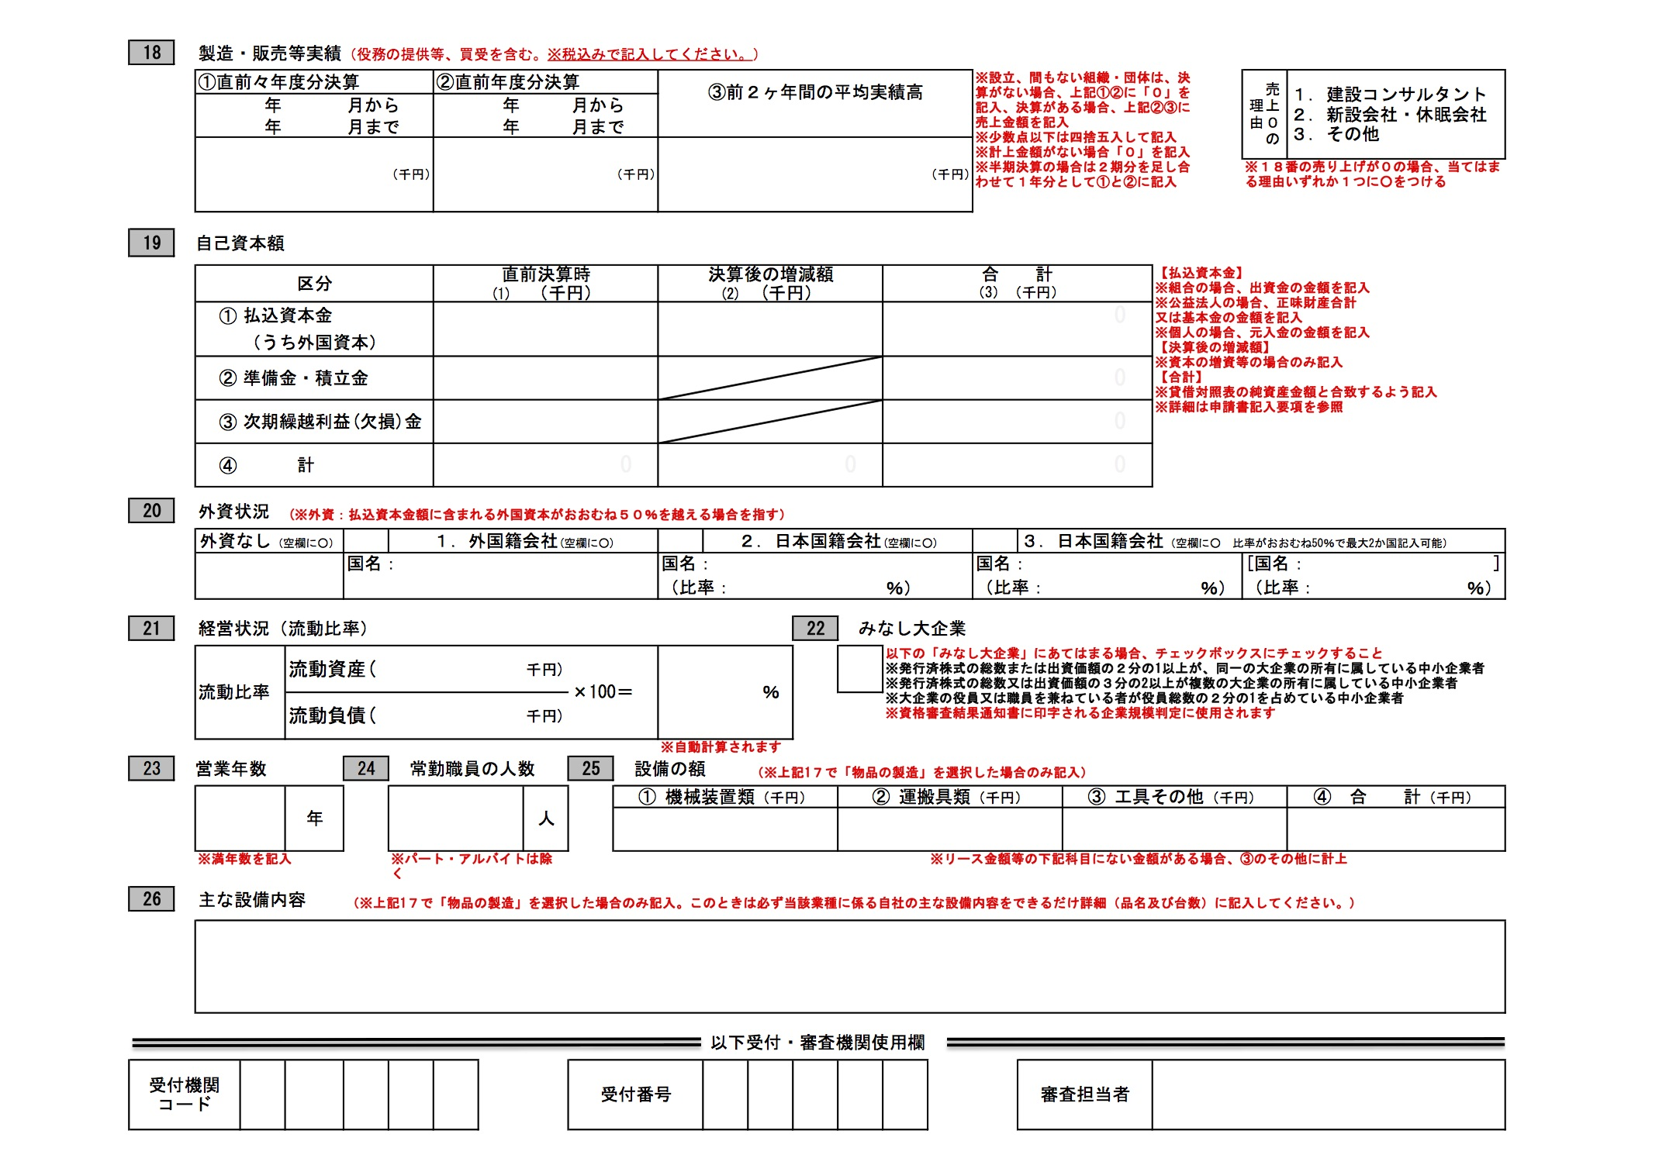
turnover
Equity & reserves
Quick
ratio
Equipment value
Notes:
The last page of the application form will probably make up most of the work, as it deals with the financial aspects of your company.
The figures entered here need to correspond with the numbers that you have in your financial statement.
Please note here that you need to recalculate all figures from your currency into Japanese yen, using an official exchange rate set by the Japanese government. This exchange rate is published on the website of the Ministry of Finance. Do not use the exchange rate of the day you are submitting your application!
It should be financial statements of a closed book year, preferably certified by an accountant, The statement should include a balance sheet and a profit and loss statement.
Japan accounting standards are a bit different from European ones, but the Items that should at least be visible in your statements are
Annual turnover
Equity & reserves
Foreign capital (if applicable)
Quick Ratio
Also filled in here are:
Number of regular employees (This can be confusing sometimes for companies which work with freelancers) Regular workers are those paid fixed and regular incomes, for whom the company pays social security premiums.
25. If you which to manufacture products on commission for the government you will also have to state the value of your fixed assets.
Make sure that the information provided here corresponds exactly with the documents you submit.

Slide 15
Unified supplier Qualification
Forms to submit
Topic 1
Topic 2
Topic 3
Topic 4
Contact
Required | Company/individual | Form
Y | All | Application form
Y | Company | Company registration (copy)
Y | All | Proof of payment of taxes (copy)
Y | All | Financial Statement (1 year)
Y | All | Business History
Y | Company | Signed pledge and list of executives
N | All | Letter of attorney (if necessary)
N | All | Foreign character notification (if necessary)
N | All | Detailed report on depreciation of assets (if necessary)
www.EUbusinessinJapan.eu
Notes:
As I said in the previous slide, Accounting methods and concepts in Japan differ in some aspects from what is common in EU countries.
When preparing a Japanese translations try to make sure that the accepting organisation can check the figures that are asked in the application form, such as turnover and Liquid Ratio. The Helpdesk can assist you with this.

Slide 16
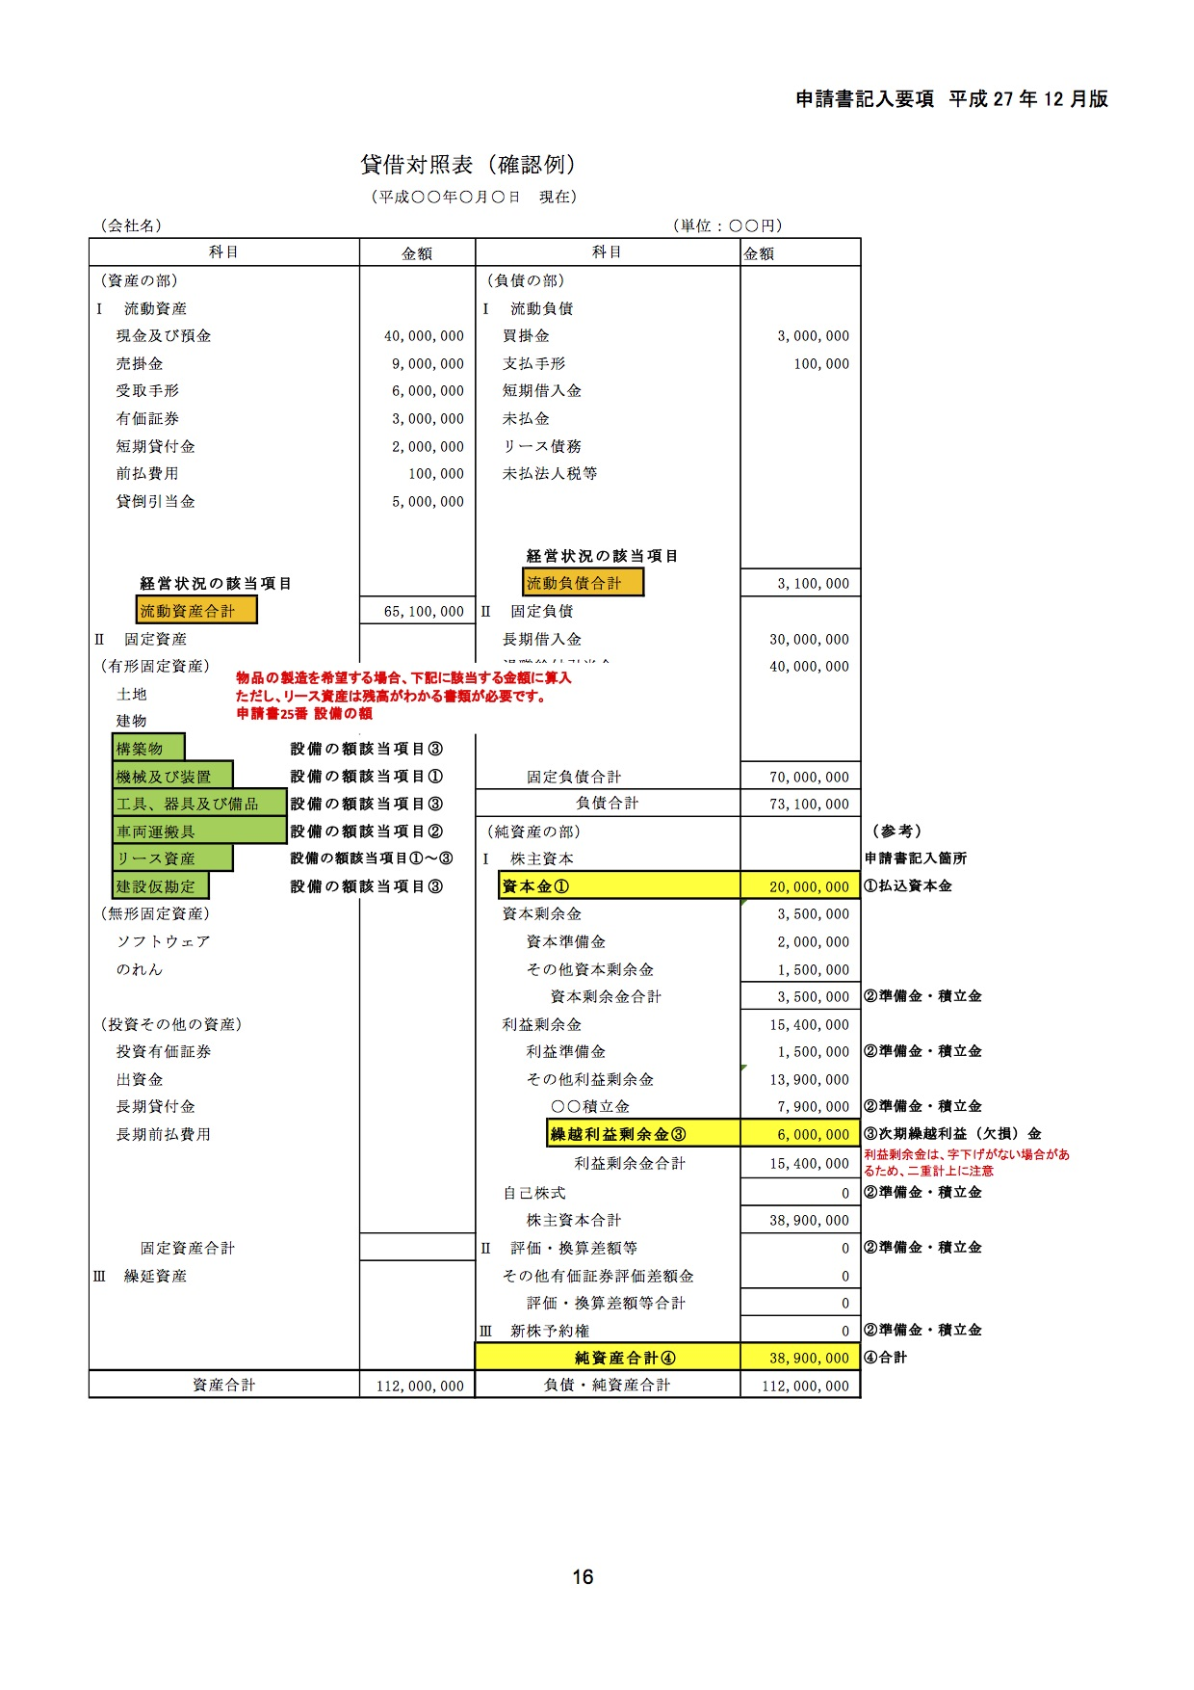
Sample balance sheet
Notes:
This is a sample balance sheet as it is provided in the Japanese guide for the application. The coloured items here are the ones that are used in the assessment.

Slide 17
Unified supplier Qualification
Forms to submit
Topic 1
Topic 2
Topic 3
Topic 4
Contact
Required | Company/individual | Form
Y | All | Application form
Y | Company | Company registration (copy)
Y | All | Proof of payment of taxes (copy)
Y | All | Financial Statement (1 year)
Y | All | Business History
Y | Company | Signed pledge and list of executives
N | All | Letter of attorney (if necessary)
N | All | Foreign character notification (if necessary)
N | All | Detailed report on depreciation of assets (if necessary)
www.EUbusinessinJapan.eu
Notes:
To move on to the business history document.

Slide 18
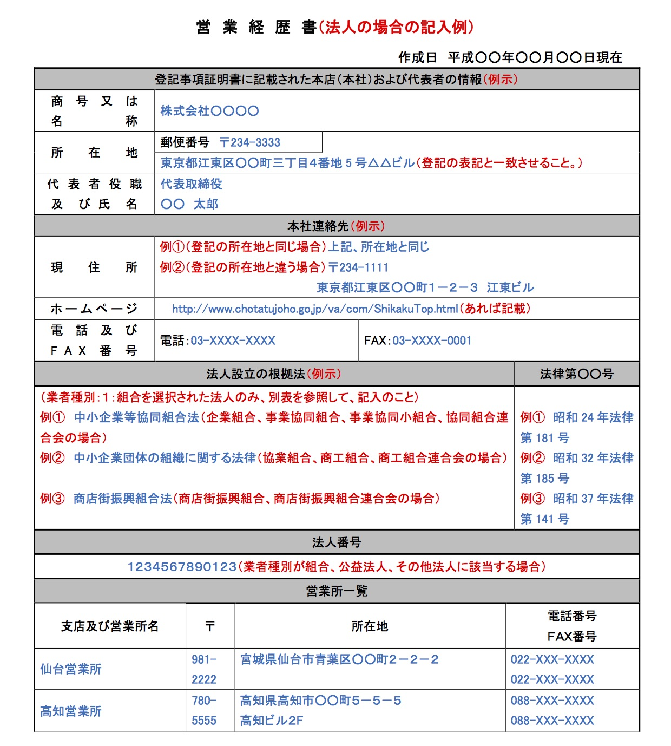
Business history
Your company’s CV
Contact details
Main business activities
Major achievements
(Technical capabilities, licenses
Historical timeline (year of establishment, enlargement, conspicuous dates in your company’s existence)
Notes:
The business history is more or less free form, but a template is provided as well. It is not a legal document of any kind, but very commonly used in Japan, it is basically your company’s CV.
It should contain the contact details again, homepage, addresses of branch companies if applicable.
Outline of your activities, and list of important dates in your companies existence.
Make sure that the information provided here, is consistent with the information provided in the application form.

Slide 19
Unified supplier Qualification
Forms to submit
Topic 1
Topic 2
Topic 3
Topic 4
Contact
Required | Company/individual | Form
Y | All | Application form
Y | Company | Company registration (copy)
Y | All | Proof of payment of taxes (copy)
Y | All | Financial Statement (1 year)
Y | All | Business History
Y | Company | Signed pledge and list of executives
N | All | Letter of attorney (if necessary)
N | All | Foreign character notification (if necessary)
N | All | Detailed report on depreciation of assets (if necessary)
www.EUbusinessinJapan.eu
Notes:
This is a new addition to the application. I am not showing the document here. But you are expected to sign a pledge stating that you are not involved in organized crime.
This is a more domestically necessary measure to weed out the involvement of organized crime (in particular in construction) You also need to attach a list of names of the executives in your company.

Slide 20
Unified supplier Qualification
Forms to submit
Topic 1
Topic 2
Topic 3
Topic 4
Contact
Required | Company/individual | Form
Y | All | Application form
Y | Company | Company registration (copy)
Y | All | Proof of payment of taxes (copy)
Y | All | Financial Statement (1 year)
Y | All | Business History
Y | Company | Signed pledge and list of executives
N | All | Letter of attorney (if necessary)
N | All | Foreign character notification (if necessary)
N | All | Detailed report on depreciation of assets (if necessary)
www.EUbusinessinJapan.eu
Notes:
The last three in this list are not in every case, but in case they are necessary.
Letter of attorney
In the case that you have a representative do the application for you, you need to submit a letter of attorney together with your application. This letter is only valid for the duration of the the application process, he/she cannot act as your representative in tender procedures on the basis of this document.
Foreign character notification
Necessary in case your company name includes characters which the application system cannot deal with. Most common western characters will be accepted though.
Detailed report on depreciation of assets
Necessary of your financial statement contains substantial amount of leased assets.

Slide 21
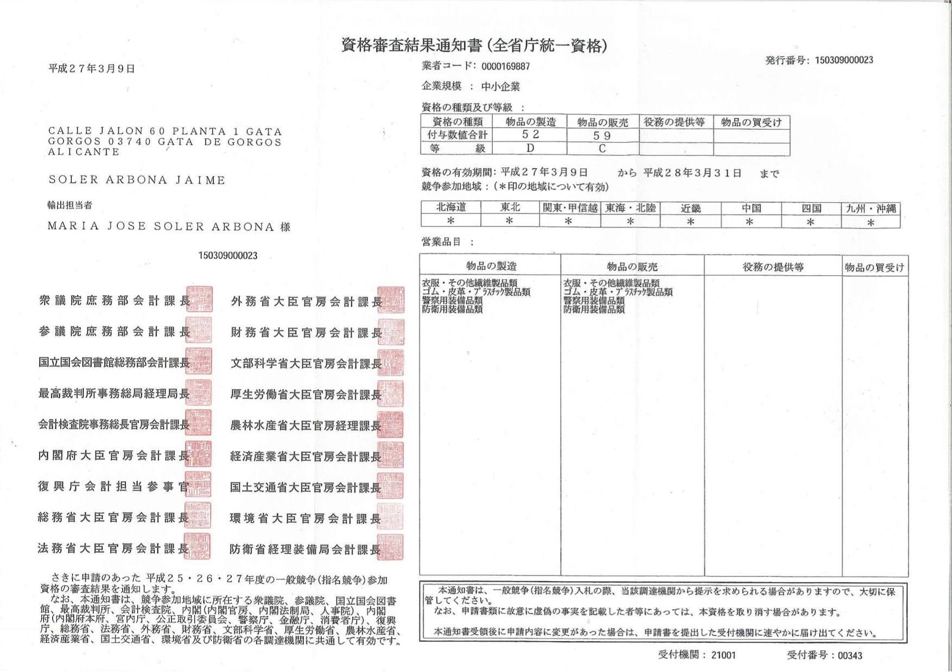
The notification
Title
Point score
Topic 1
Topic 2
Topic 3
Topic 4
Contact
Classification
Regions valid
Product categories covered
www.EUbusinessinJapan.eu
Notes:
If your application has been completed and approved, you will receive a document looking like this. If during the application process there are additional questions, you can ask them to contact you via email or phone.
It is send to an address that you need to specify in the application. In the past, we had reports that some offices refuse to send it abroad, but other EU companies say that they have received the documents directly.
It will give the point score and classification for the business categories you have specified (here a D for manufacturing and a C for sales) that has come out of the examination of your application, the regions where it is valid for (here all areas) and the product categories covered.

Slide 22
Usage of classification
Topic 1
Topic 2
Topic 3
Topic 4
Contact
Manufacturing
Points | Classification | Range of contract (estimated price)
>90 | A | > € 230,000
>80-90 | B | < € 155,000 > € 230,000
>55-80 | C | <€ 31,000 - € 155,000
<55 | D | < € 31,000
Sales of goods and services
Points | Classification | Range of contract (estimated price)
>90 | A | > € 230,000
>80-90 | B | < € 117,000 > € 230,000
>55-80 | C | <€ 23,000 - € 117,000
<55 | D | < € 23,000
www.EUbusinessinJapan.eu
Notes:
Point score
The point score (max 100 points) is calculated on the basis of the information you have provided, primarily your turnover, equity, liquid ratio, years in business and value of your production assets (in case of manufacturing).
The height of your turnover carries the largest weight.
In practice most SMEs (looking at the EU definition of SMEs) will end up at first with a classification of either C or D
(Click)
The government entities use the supplier qualification to limit the number of suppliers which can take part in open competitive tender procedures.
On the one hand they can reserve projects to give smaller companies a chance to secure contracts, while on the other hand they can limit tenderers for large projects by reserving a tender for A and/or B class companies.
What we see in our monitoring of international WTO tenders issued by Japanese organizations is that in terms of classification A,B,C is most common.
This is an example of how the classification is used in tenders. This tender is thus open for companies in possession of qualification A, B or C who have registered offering services and have registered for the Kanto-Koshinetsu (Tokyo and surroundings)

Slide 23
Tender participation qualification for construction and design
Topic 1
Topic 2
Topic 3
Topic 4
Contact
Coverage: Construction and design
Scope: Individual government entities
Two-tiered system
Keishin (business evaluation)
Application with entity
Validity: Max. 1 year and 7 months
Costs: business assessment by third party, MLIT
Where to apply: MLIT or prefectural governor, then at each entity
www.EUbusinessinJapan.eu
Notes:
Now, I would like to move on the a discussion of the qualification for participation in construction and design related tenders.
I will discuss the qualification process for construction and design of public works only briefly today. It is a wholly separate system from the one we discussed so far, and entails substantial paperwork.
Scope:
The Scope of the qualification is limited to individual government entities. So for each specific entity you need to apply separately to qualify for participation in tenders.
Two tiered system
The most important common feature is the business assessment system or keishin for short, which uses nation-wide unified standards. As such keishin has become synonymous for the qualification. The system is therefore a two-step process
Validity
It states here that the qualification is valid for 1 year and 7 months (with is actually the length of validity of keishin business evaluation), but in practice you will need to renew the qualification annually in order to prevent gaps in your eligibility.
Costs
The qualification process is not entirely free, partly because of the need of the keishin conducted by a third party. Costs can vary from 100 to 250 euro’s. Costs are also involved for the screening by MLIT and will depend on the number of business activities (starts at 8100 yen)
Where to apply:
While you have a each entity individually, however the keishin business evaluation is a the system as a whole has common features in terms of procedures.

Slide 24
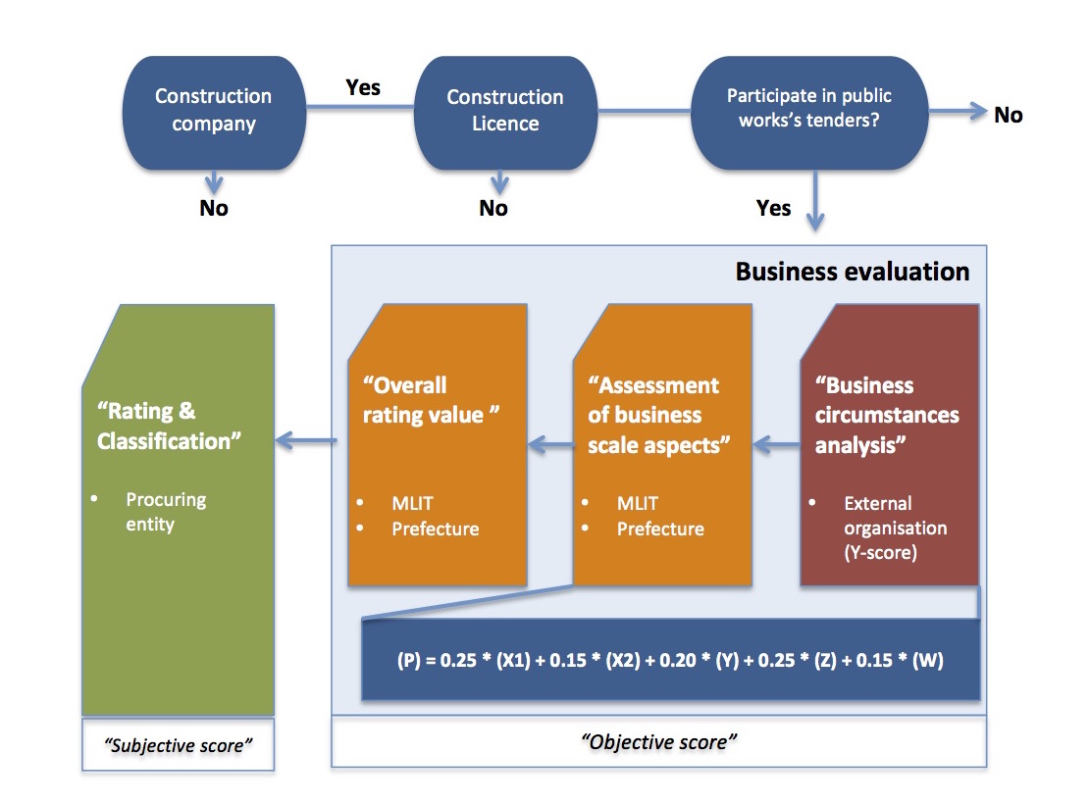
Construction qualification
Process flow
Topic 1
Topic 2
Topic 3
Topic 4
Contact
Notes:
This is a simplified schematic overview of the process for application.
I am not treating the construction license here, as this is not directly linked to public works construction tenders
The first step is a business circumstance analysis (keiei joukyou bunseki) undertaken by an external company.
There are presently 11 companies in Japan which are designated to conduct this analysis. (A list is available on our website, however none of these companies provide the service in English)
They will require a variety of financial documents to perform the analysis such as financial statements of the past 3 years. As the process is also in Japanese in its entirety, you will have to submit translations as well. Online application is possible with some of these companies (beware of the sometimes ancient computer environment it requires)
This analysis will result in a document with a point score on it, the Y score.
With this document in your possession, you can apply with MLIT or the governor of a prefecture for the Assessment of business scale aspects” (keiei kiboto hyouka) and the resulting overall rating value (sougou hyoutei chi) ( or P-score) MLIT or the prefecture will look at a more wider range of aspects of your business to determine the other values in the P-score.
Together with the document showing your Y-score you will have to submit a variety of documents to support the information that you provide in the application. Besides having all your documents translated, you can also expect here to have to do a number of additional procedures, such as having the qualifications of your engineers and other specialists recognized by MLIT.

Slide 25
Construction qualification
“Objective overall score (P-score)
Topic 1
Topic 2
Topic 3
Topic 4
Contact
(P) = 0.25 * (X1) + 0.15 * (X2) + 0.20 * (Y) + 0.25 * (Z) + 0.15 * (W)
X1 | Turnover gained from completed works by type of work
X2 | Capital and average profit
Y | Y expresses the business situation generated from 8 indicators including Ordinary profit ratio, Return on assets, Capital ratio, Business cash flow (absolute) and Accumulated earnings (absolute) Each of these indicators also has its own weight and is put into a formula.
Z | In-house registered accountants, engineers and specialists, turnover of completed prime contractor work
W | Other items such as employee welfare, number of years in business, presence/absence of application for corporate rehabilitation, contributions to disaster prevention, law-abidingness, construction accounting situation, R&D, Machinery, ISO
www.EUbusinessinJapan.eu
Notes:
which takes into a account a broad range of aspects of your business, not just the scale of your business but also technological abilities, number of engineers and other aspects such as CSR. The formulate used to calculate the P-score is adjusted from time to time to change the weights of each of the aspects/factors.
This is a short explanation of what each of the values represents, with the Y score produced by the third party.
The W-score is often used by the government to promote policies such as two years ago where higher weight is attached to company’s extent of providing training and hiring of young engineers, to counter labour shortages in the sector.

Slide 26
Construction qualification
Process flow
Topic 1
Topic 2
Topic 3
Topic 4
Contact
Notes:
The business evaluation part results into a so-called ‘objective score” which is the P-score. (The score can range between 280 and 2133 points) With the document this procedure generates you can then apply with the procuring entity for supplier qualification for that specific organisation. Which will result in a so-called “subjective score” based upon the standards used by that organisation, on the basis of which you are that rated. The procuring organisation will use these scores to specify particular tender contracts for a particular class of construction companies.
When the business evaluation has been completed the overall score is used by each procuring entity (subjective score) to rate and classify their suppliers in this sector. So your company’s supplier qualification is decided by the procuring entity. The P-score can be used both at the national level and the regional and local level and is accepted throughout the country.
The complexity of this system has basically lead to foreign companies being absent from this sectors as direct bidders. Most complaints from foreign companies with this system deal with the fact that the business evaluation has to be done every year in order to stay eligible and is administratively burdensome.

Slide 27
Tender participation qualification
at regional/local level
Topic 1
Topic 2
Topic 3
Topic 4
Contact
www.EUbusinessinJapan.eu
Notes:
To move on to the final part of my presentation today: Tender participation at the regional and local level.
I am using Tokyo Metropolitan Government (TMG) here as a case, but the systems will largely be similar elsewhere.
You are looking here at the Central Procurement website run by TMG. Which also includes links to the tender participation qualification application, (shown in red)

Slide 28
Supplier qualification
Tokyo Metropolitan government
Topic 1
Topic 2
Topic 3
Topic 4
Contact
Validity: max two years (March ‘17)
Coverage: Goods and services
Scope: Tokyo metropolitan government (not wards or cities within greater Tokyo)
www.EUbusinessinJapan.eu
Notes:
Validity:
Supplier qualification are shorter than the national one we discussed earlier. For Tokyo the present cycle is until March 2017
Coverage:
I am referring here to qualifications for the supply of goods and services only. For construction and design-related qualifications again a separate procedure exists, which was partly covered in the previous slides.
Scope: The qualification covers only public procurement by the Tokyo Metropolitan Government. Note that the the wards or –ku and cities within Tokyo operate their own registration system.

Slide 29
Scope
Topic 1
Topic 2
Topic 3
Topic 4
Contact
Bureau of Finance
Tokyo 2020 Olympics and Paralympic Games Preparation Bureau
Hospital Management Bureau
Bureau of Transportation
Bureau of Construction
Bureau of Waterworks
Bureau of Sewerage
Tokyo Police Department
Tokyo Fire Department
Etc.
www.EUbusinessinJapan.eu
Notes:
The qualification covers most of TMGs various bureau’s, such as the ones listed here.
But not procurement at Ward or city level.
To participate in tenders related to the preparation of the Tokyo 2020 Olympics, this qualification will cover most procurement.

Slide 30
Supplier qualification
Tokyo Metropolitan government
Topic 1
Topic 2
Topic 3
Topic 4
Contact
Validity: max. 2 years (March ‘17)
Coverage: Goods and services
Scope: Tokyo metropolitan government
Digital ID necessary to apply
Costs: Digital ID, application free
Processing time: 3-5 days
www.EUbusinessinJapan.eu
Notes:
A complicating factor for participation in tender procedures in Tokyo is the necessity to obtain a digital ID.
This can only be obtained, if you have a legal presence in Japan.
If you do not have an digital ID you cannot apply for the qualification or take part in online tender procedures.
The Digital ID and only procurement system require a specific technical environment, which can be quite complicated.
Costs:
Like the national one, there are no costs involved with the application itself, but you will need to purchase an Digital ID and equipment such as a card reader (if you have a card)
Processing time of the application itself is 3-5 days

Slide 31
Supplier qualification
Tokyo Metropolitan government
Topic 1
Topic 2
Topic 3
Topic 4
Contact
Documents you need to submit:
Application (online)
On paper possible
Financial statements
Company registration
Copy of licenses, quality assurance certificates (if applicable)
www.EUbusinessinJapan.eu
Notes:
TMG does not provide publicly available information about what kind of documents foreign companies need to submit, as it caters exclusively for domestically based companies.
Application is in principle online only, but if you contact TMG they will also provide you with documents. (Needs to be done in Japanese)
You need to send supporting documents (with translations) by mail, such as financial statements and company registration.

Slide 32
Supplier qualification
Tokyo Metropolitan government
Topic 1
Topic 2
Topic 3
Topic 4
Contact
Assessment and classification
Objective score
Three classes, A,B, or C for each business item based upon:
Annual turnover
(ISO certificate represent more points)
Equity
No. of employees
Quick Ratio
Years in business
www.EUbusinessinJapan.eu
Notes:
The information regarding turnover, equity, no of employees, Quick ratio and years in business is used to calculate a numerical ‘objective score, which is given a classification A, B or C for each business item you have applied for.

Slide 33
Supplier qualification
Tokyo Metropolitan government
Topic 1
Topic 2
Topic 3
Topic 4
Contact
Assessment and classification
Objective score
Subjective score
A,B,C based upon the turnover of a specific business item
Contract values linked to classification
Values differ per business category
> 70 | A
>40-<70 | B
<40 | C
www.EUbusinessinJapan.eu
Notes:
Objective score
Max 105 points (in case of performance of service or commissioned manufacturing of product) 100 for sales of product
Subjective score
Based upon the turnover of a specific business item. If a company scores an A for the objective score, but a B for the turnover in the year of application. The company will be classified as B.
Linked to this classification are the size of the contract offered. TMG uses different contract sizes for different business items.
In general, when applying for qualifications, please keep in mind that Tokyo and other regional and local government do not take foreign suppliers into account, and that it is advisable to consult with the organization in question at an early stage.

Slide 34
JTTP Helpdesk
Support
Topic 1
Topic 2
Topic 3
Topic 4
Contact
Unified Supplier Qualification
Offered free for first application
Keishin/Construction qualifications
Custom-made support possible, upon request
Regional/Local Qualifications
Custom-made support possible, upon request
www.EUbusinessinJapan.eu
Notes:
JTPP Helpdesk offers support for European SMEs with obtaining supplier qualifications.
For a first application for a Unified Supplier Qualification this is offered for free, where the Helpdesk arranges the Qualification for you (including translations)
Due to the complexity of Keishin and regional local qualifications JTPP Helpdesk can give logistical custom-made support, costs will however depend on the level of support that is needed.

Slide 35
More information
Topic 1
Topic 2
Topic 3
Topic 4
Contact
http://www.eubusinessinjapan.eu/
issues/entry-strategy/government-procurement
Or contact us via the online Ask-the-Expert form
www.EUbusinessinJapan.eu
Notes:
More detailled information on qualifications and other issues regarding public procurement in Japan can be found at this website.
If you have specific questions or require specific support please contact us via the online Ask-the-Expert form

Slide 36
Questions
Topic 1
Topic 2
Topic 3
Topic 4
Contact
Your questions
www.EUbusinessinJapan.eu
Notes:
This end my presentation for today, If you have any immediate questions, I will be glad to answer them.

