Slide 1
JTPP: Case studies
Topic 1
Topic 2
Topic 3
Topic 4
Contact
Public Procurement in Japan
– Experiences of a European SME-
Japan Tax & Public Procurement Helpdesk
www.EUbusinessinJapan.eu

Slide 2
JTPP: Case studies
Topic 1
Topic 2
Topic 3
Topic 4
Contact
Today’s programme
Presentation by Mrs. Mitsuse Matsuki-Baltzer, CEO MB Scientific AB
Interview between Mrs. Matsuki-Baltzer and Lyckle Griek, JTPP Helpdesk Project manager
Q&A
www.EUbusinessinJapan.eu

Slide 3
Why MB Scientific AB, European SME, became active in PP market? ~ The story of 15 years experience ~
MB Scientific AB
Mitsuse Matsuki-Baltzer
Seminariegatan 29B, SE-752 28, Uppsala, Sweden
Tel: +46 18 290960, Fax: +46 18 572683
E-mail: info@mbscientific.se Homepage: www.mbscientific.se

Slide 4
Why MB Scientific AB, European SME, became active in PP market? ~ The story of 15 years experience ~
Abstract
1. Introduction of myself
2. Background & motivation
3. MB Scientific activity in the PP market
4. A wish for the future about European SME:s
in the Japanese PP market

Slide 5
Why MB Scientific AB, European SME, became active in PP market?
1. Introduction of myself
1969: Born in Osaka Japan
1992: Finished education and became material analysis engineer
1999: Moved to Uppsala, Sweden and started to work at Swedish scientific analysis instrument maker
First successful sales in PP market!
2001: started MB Scientific AB in Uppsala Sweden
2nd success for SME in PP market!

Slide 6
Why MB Scientific AB, European SME, became active in PP market?
2. Background story & motivation
July 1999 Gammadata Scienta AB lost its Japanese representative company by bankruptcy.
All Japanese Scientists and Professors were asking to make Direct Purchase.
No more high cost and better communication wanted!
Was it impossible or not? --- There was no example!
Problems needed to be solved for Direct Sales;
1) Pricing in JPY
2) Bank account in Japan - Non resident account at MUFG
3) Educate administrators about incoterms DDP and VAT payment
Join the Public Procurement process required evaluation for tender license rank A ,B,C or D.

Slide 7
Why MB Scientific AB, European SME, became active in PP market?
3. MB Scientific activity in PP market
April 2006 we have applied for our first tender license to the Japanese ministry of science and education via internet and received rank “D” state for all 3 categories “a: manufacturing”, “b: sales” and “c: consultations”.
We have updated this license 4 times and latest rank is
“D” for “a: manufacturing”, “C” for “b and c”.

Slide 8
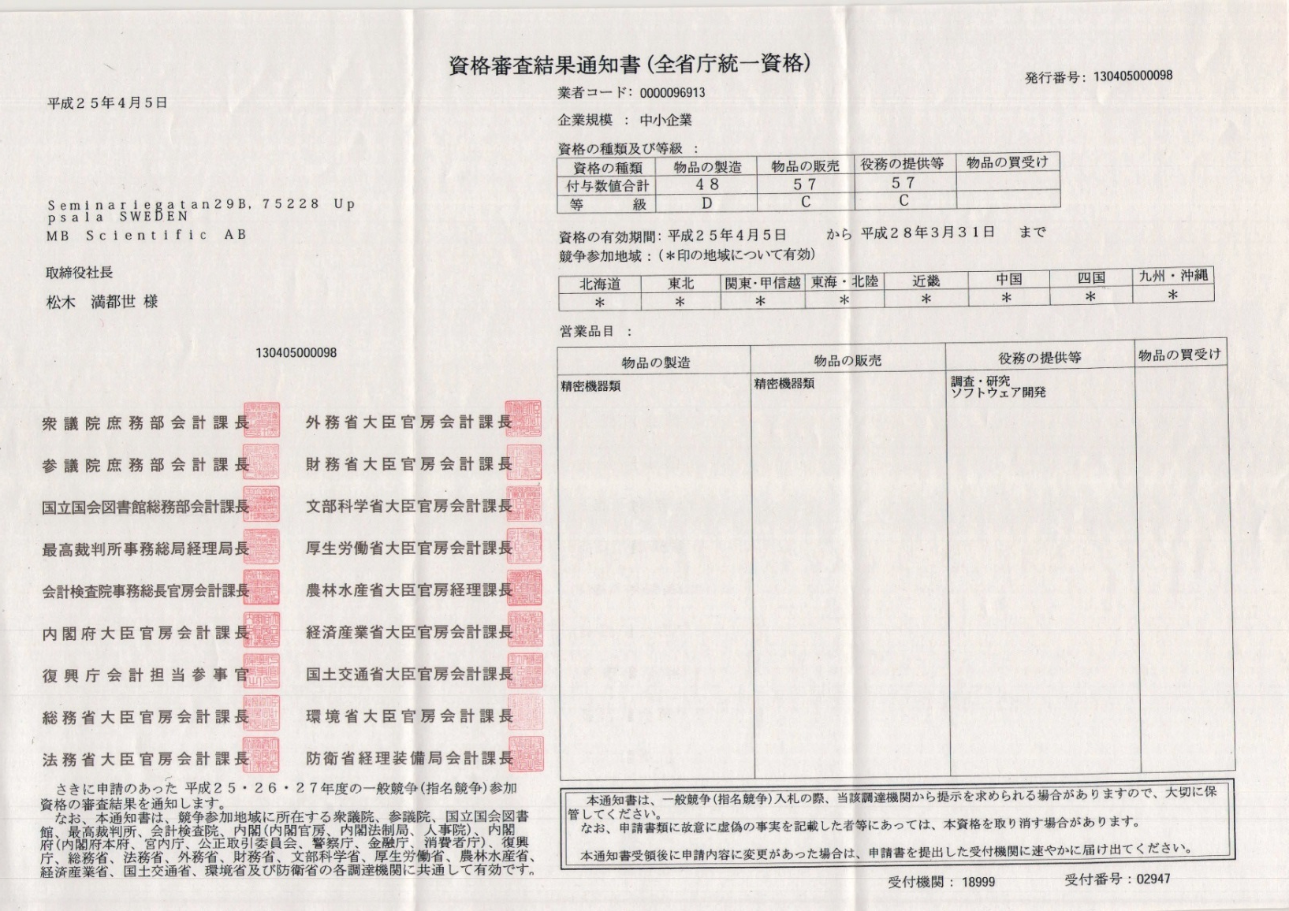
Why MB Scientific AB, European SME, became active in PP market?
3. MB Scientific activity in PP market

Slide 9
Why MB Scientific AB, European SME, became active in PP market?
3. MB Scientific activity in PP market

Slide 10
Why MB Scientific AB, European SME, became active in PP market?
4. A wish for the future about European SME:s
in the Japanese PP market
EU has its own system to register SME:s to be
Beneficiaries and if this data can be shared
with the Japanese PP system
it would be much easier to join
the Japanese PP market.

Slide 11
Why MB Scientific AB, European SME, became active in PP market?
Thank you for listening!
MB Scientific AB
Mitsuse Matsuki-Baltzer

Slide 12
JTPP: Case studies
Topic 1
Topic 2
Topic 3
Topic 4
Contact
Interview
Mrs. Mitsuse Matsuki, MB Scienftic AB
Mr. Lyckle Griek, Japan Tax and Public Procurement (JTPP) Helpdesk
www.EUbusinessinJapan.eu

Slide 13
JTPP: Case studies
Topic 1
Topic 2
Topic 3
Topic 4
Contact
Question 1:
“How do you find tenders suitable for your business?”
www.EUbusinessinJapan.eu

Slide 14
JTPP: Case studies
Topic 1
Topic 2
Topic 3
Topic 4
Contact
Question 2:
“Do you have many competitors in your sector?”
www.EUbusinessinJapan.eu

Slide 15
JTPP: Case studies
Topic 1
Topic 2
Topic 3
Topic 4
Contact
Question 3:
“After you have won a tender, how do you deal with the contracting? Can you do this from Sweden, or do you have to go to Japan and do it in person?”
www.EUbusinessinJapan.eu

Slide 16
JTPP: Case studies
Topic 1
Topic 2
Topic 3
Topic 4
Contact
Your questions!
(Please state to whom to wish to ask your question)
www.EUbusinessinJapan.eu

Slide 17
Japan Tax & Public Procurement Helpdesk (JTPP)
JTPP: Case-study
Topic 1
Topic 2
Topic 3
Topic 4
Contact
Find us at
www.Eubusinessinjapan.eu
Twitter: @JTPPHELPDESK
www.EUbusinessinJapan.eu

